Slide 1
CENG 302 Conceptual Design Activity: GeneBank
By
Taha Ahmad
2546125

Slide 2
Specifications
The database is structured around central Gene entities, each associated with a single Species in a one-to-many relationship. Research Projects are composed of aggregated ProjectActivities, including Samples, Experiments, and Publications. These projects are led by Researchers. The GeneSequence is a weak entity, dependent on the Gene for its identity, exemplifying a many-to-one relationship.

Slide 3
Schema
Entities:
Gene(geneID, genename , function, speciesID)
GeneSequence(sequenceID, geneID , seq_name)
Species(speciesID, common_name, scientific_name, habitat)
Sample(sampleID, geneID, projectID , sampledate)
ResearchProject(projectID, project_title, startdate , end_date, researcherID)
Researcher(researcherID , rname, affiliation, email)
Experiment(experimentID, exp_title, method , projectID, expdate)
Publication(publicationID, title, published_date, projectID)

Slide 4
Relations:
part_of_gene(sequenceID, geneID)
assoc_with_species(speciesID,geneID)
assoc_with_sampe(sampleID,geneID)
project_activities(experimentID,sampleID)
led_by(researcherID,projectID)
published_on(publicationID,projectID)

Slide 5
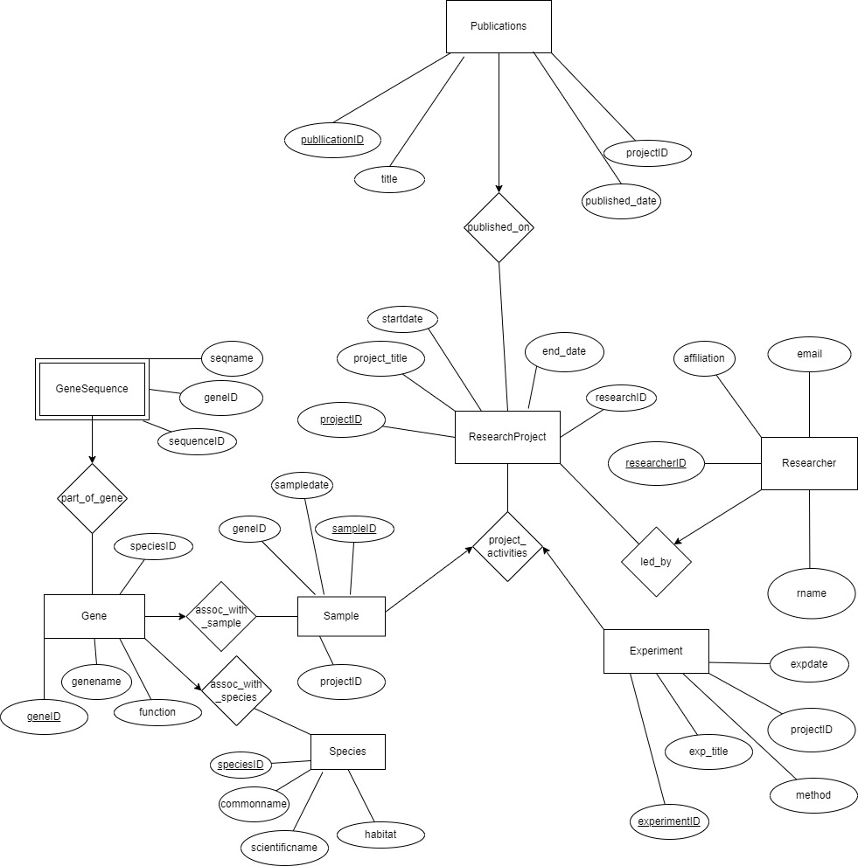

Slide 6
Normalization
Already normalized

